Slide 1
Managing dependencies on JET Composite Components at design | build | deploy | run | request time
Oracle JET Composite Components Manager
Lucas Jellema
Spring 2018

Slide 2




Referencing JET Composite Components
Meta data file describing JET Composite Components used in a JET application and to be managed by jccm. Located in src/js/jet-composites
Name
Version (min/max)
Git tag/commit/branch
URL (zip, Git Repo, Live JET app)
Phase (design, build, deploy, run, request
Command Line Interface that is run for a specific phase (install, build, deploy, run, request) reads jet-composites.json and fetches JET-Composites as required – storing them in /src/js/jet-composites/<name of component>
jet-composites.json
Locations from where JET Composites can be retrieved: - Git (incl GitHub and BitBucket) - the JET Composite Components showroom
- Live JET Application
- A zip-file at a URL
jccm
(JET Composite Component Manager CLI)
Design/Install time
Build time
Deployment time
Run time
Request time
Use jccm install to fetch composite components and save in application
Before/ at the start of ojet build, use jccm to add in Composite Components
After launching node, fetch composite components and write to local file system before starting to serve JET application
Manual, scheduled or WebHook trigger (e.g. from Git) to (re-)fetch the source of the composite component and write to local file system
Any request for artefacts of the JET Composite Component is redirected – the artefact is fetched live from a specified location (possibly with caching)

Slide 3
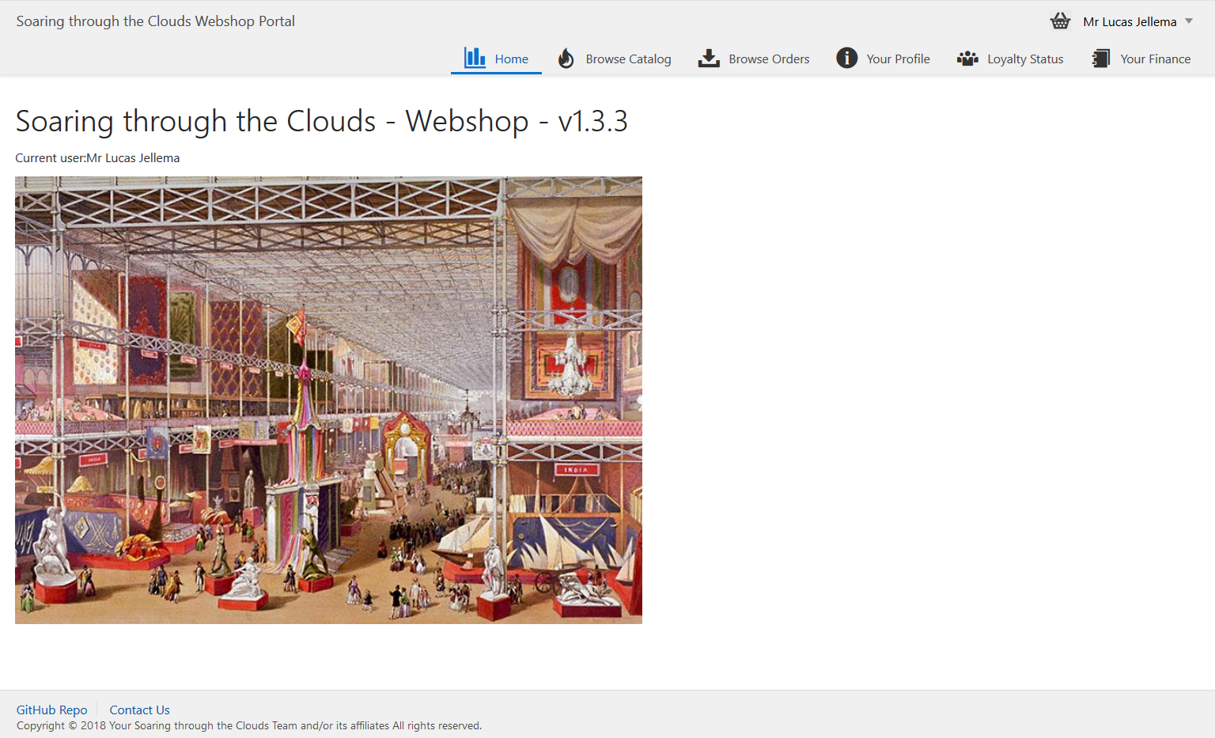
Demo of Referencing JET Composite Components
jccm
(JET Composite Component Manager CLI)
jet-composites.json
name: Comp1
version : >= 1.2
commit: <git commit>
url : <github repo url>
phase : design
name: Comp2
version : 1.0
url : <showroom>
phase : deploy
name: Comp3
branch: master
url : <github repo url>
phase : runtime
name: Comp4
url : <live app url>
phase : request

Slide 4
Demo

Slide 5
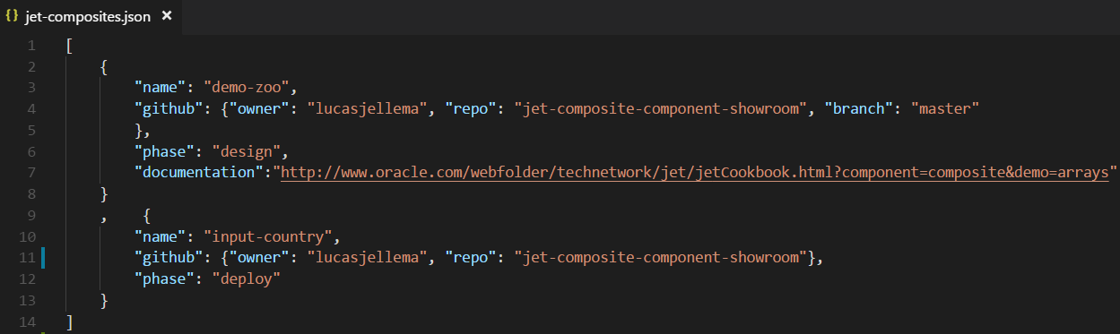
Configuration file to describe dependencies on JET Composite Components
Note how the github reference is provided as source for the JET Composite Components

Slide 6
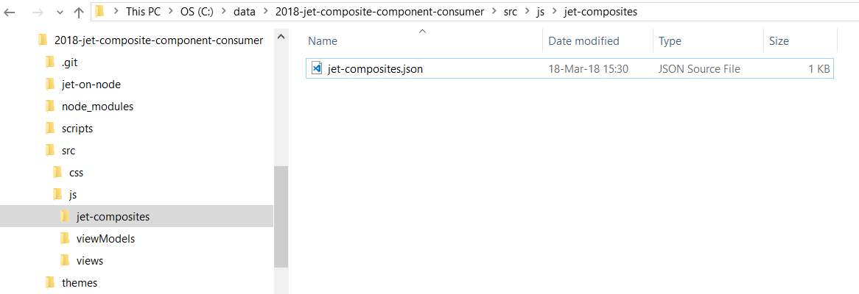
Prior to running JCCM (JET Composite Component Manager)

Slide 7
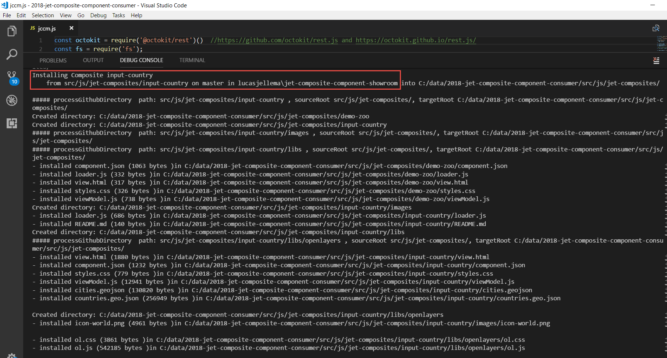
Run JCCM (design time)

Slide 8
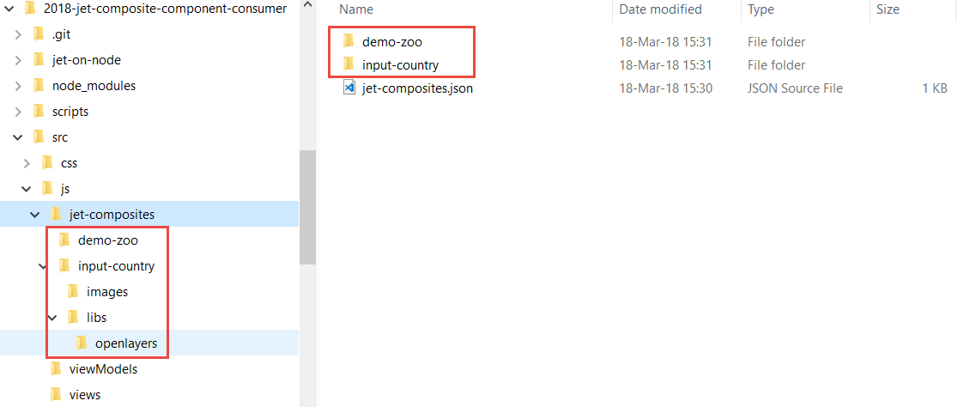
When JCCM is done
All resources for the specified JET composite components were installed
Note: JCCM can be re-run – to bring in the latest definition of the composite component

Slide 9
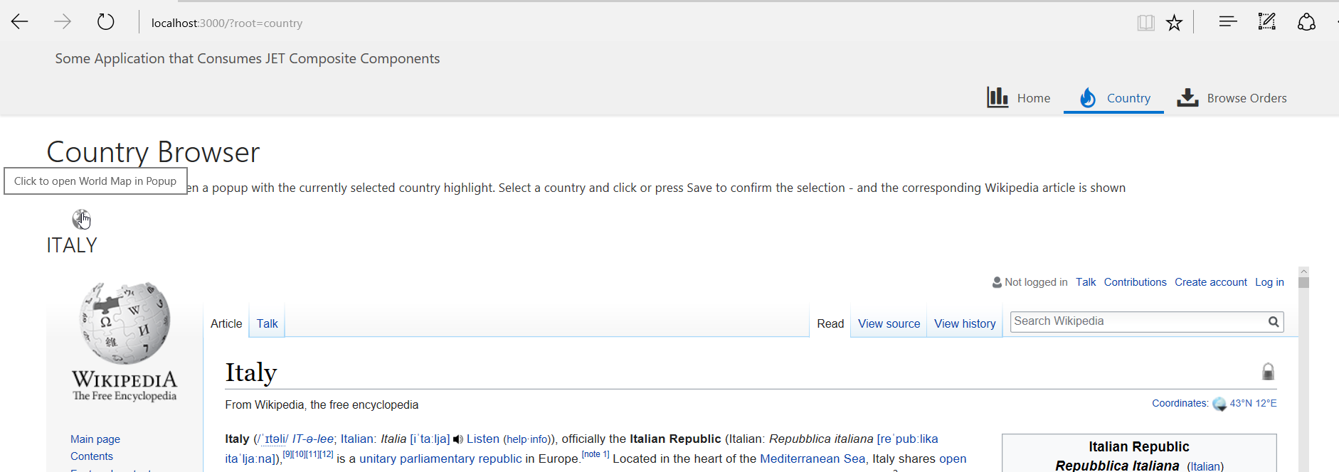
The application is running in a live environment (for example Oracle Application Container Cloud)
Note the hover text shown for the globe image

Slide 10
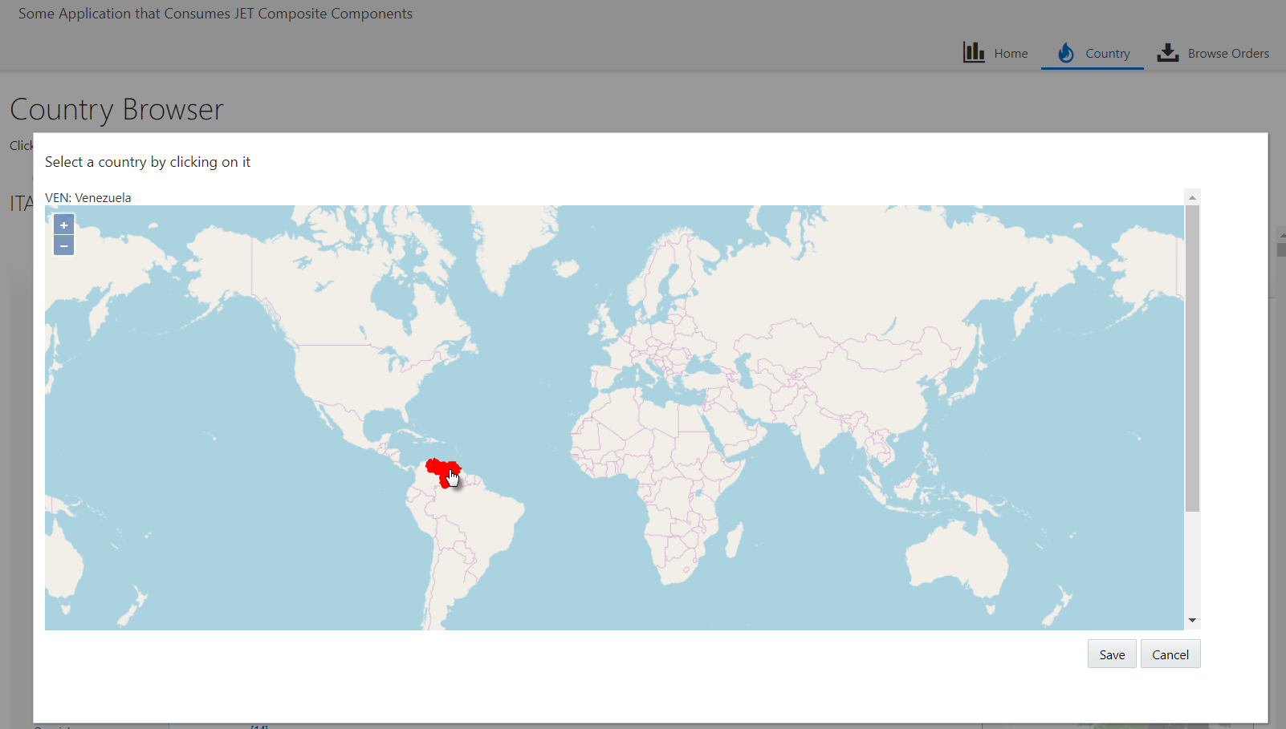
Click on country

Slide 11
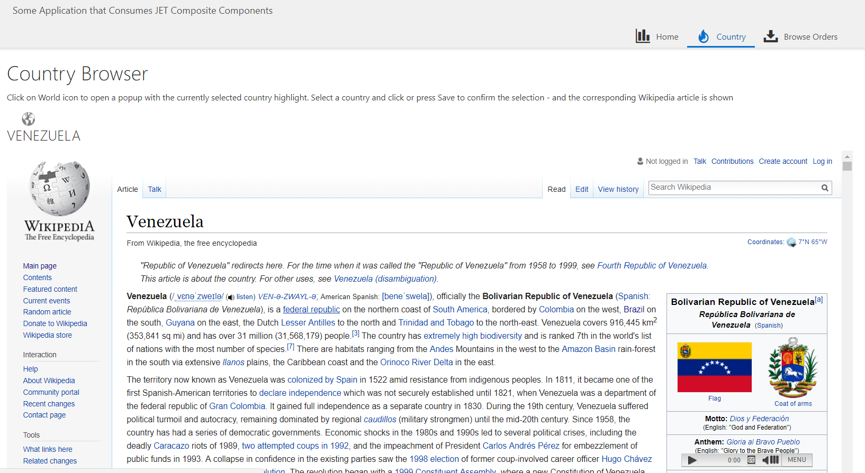
Wikipedia details for newly selected country are shown in an IFRAME

Slide 12
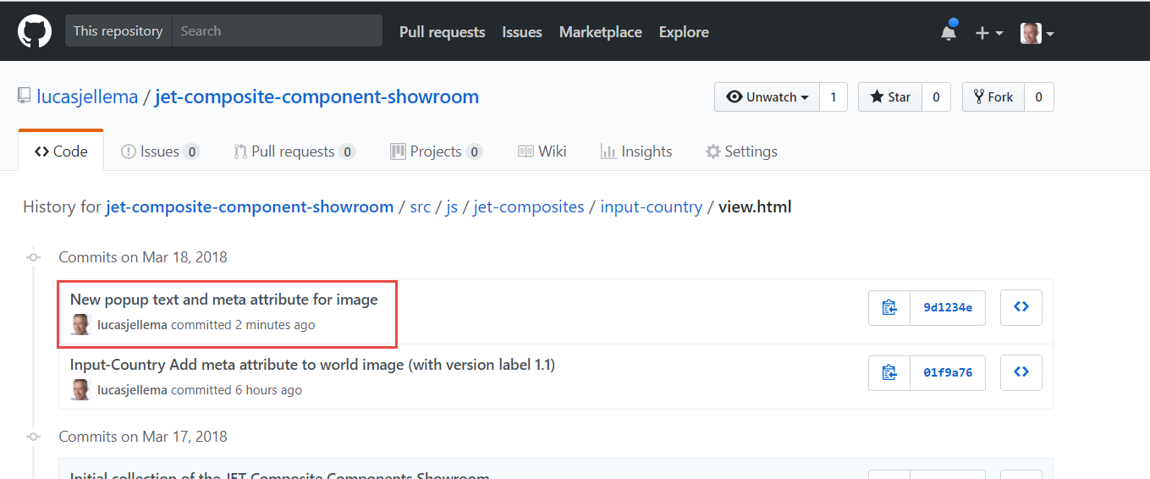
The sources of the input-country component were updated and pushed to the GitHub repository
The new version has a new text for the hover message for the globe icon
Note: currently these sources are not live anywhere

Slide 13
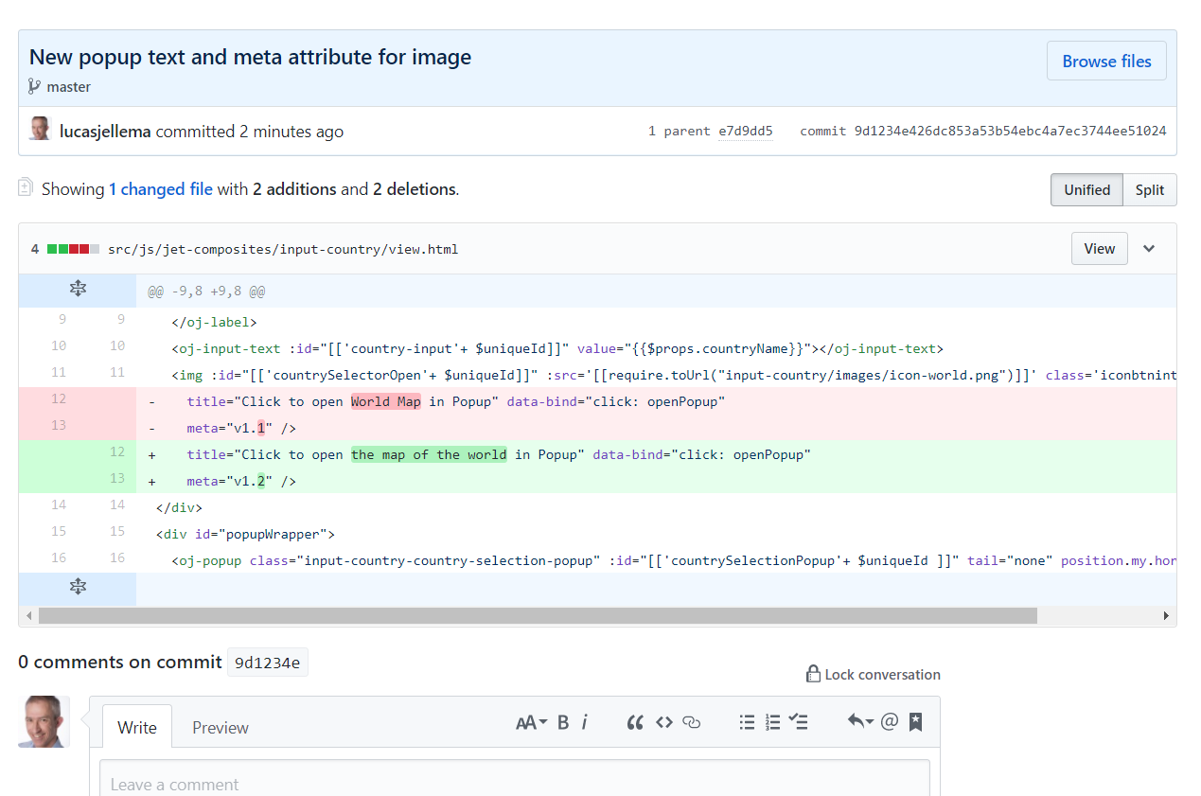
Detailed changes in JET Composite Component

Slide 14
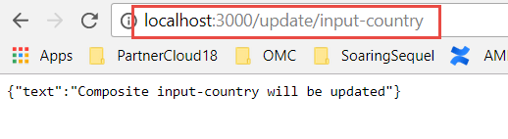
Refresh the JET Composite Component in the live application
By sending a GET request to the endpoint /update/input-country is the JET application instructed to refresh the composite component from the GitHub source defined in jet-composites.json

Slide 15
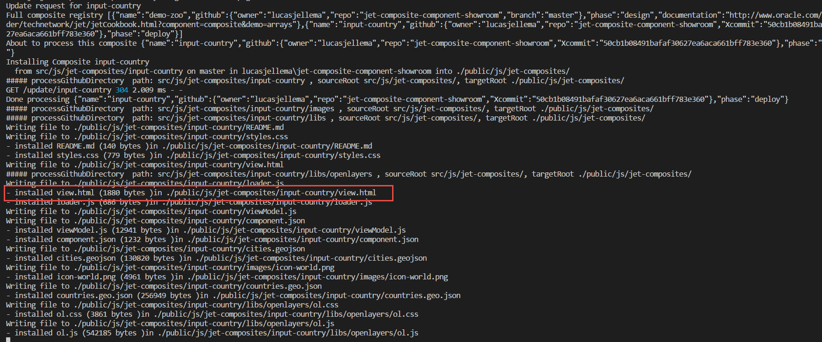
Server side logging for update of JET Composite Component

Slide 16
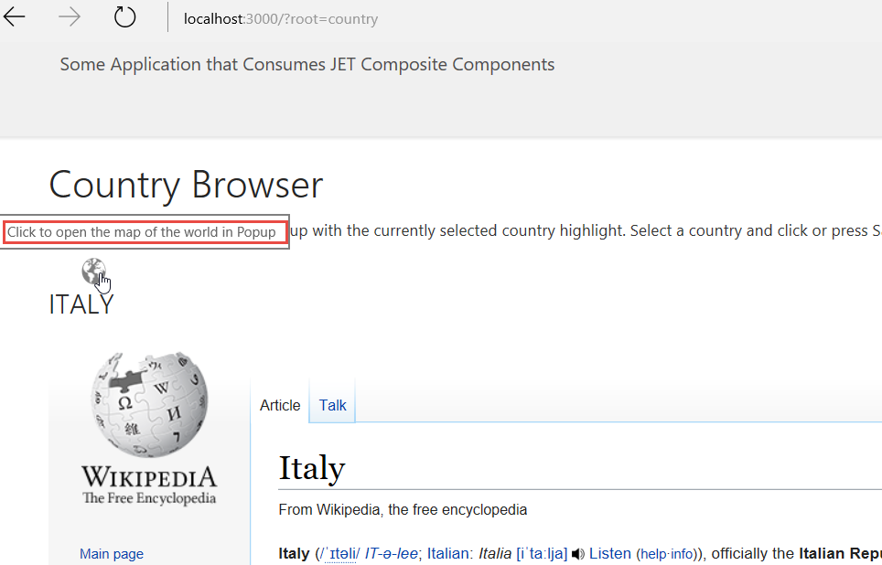
Without redeploying the application – the new version of the JET Composite Component is live

Slide 17
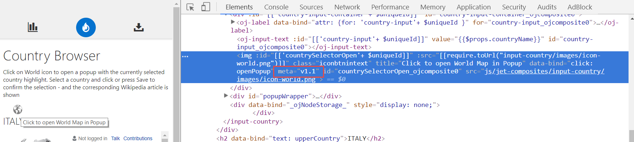
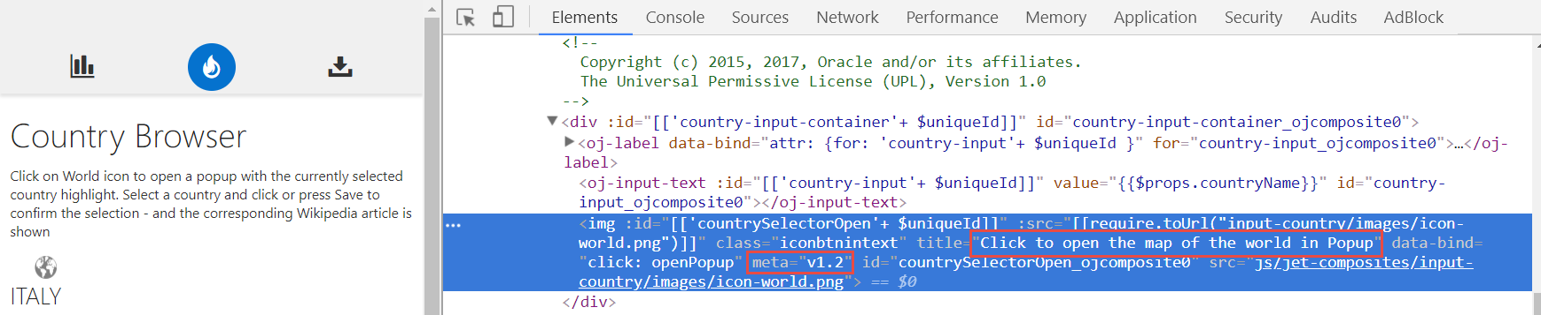
Without redeploying the application – the new version of the JET Composite Component is live
Before:
After:

Slide 18
Trigger from GitHub WebHook
Create an endpoint in the Node application that serves JET to handle the WebHook event
Check if Push includes Commits that have updated any aspect of the JET Composite Components we are interested in
If so, update these Composite Components
Configure a webhook in GitHub for the push event

Slide 19
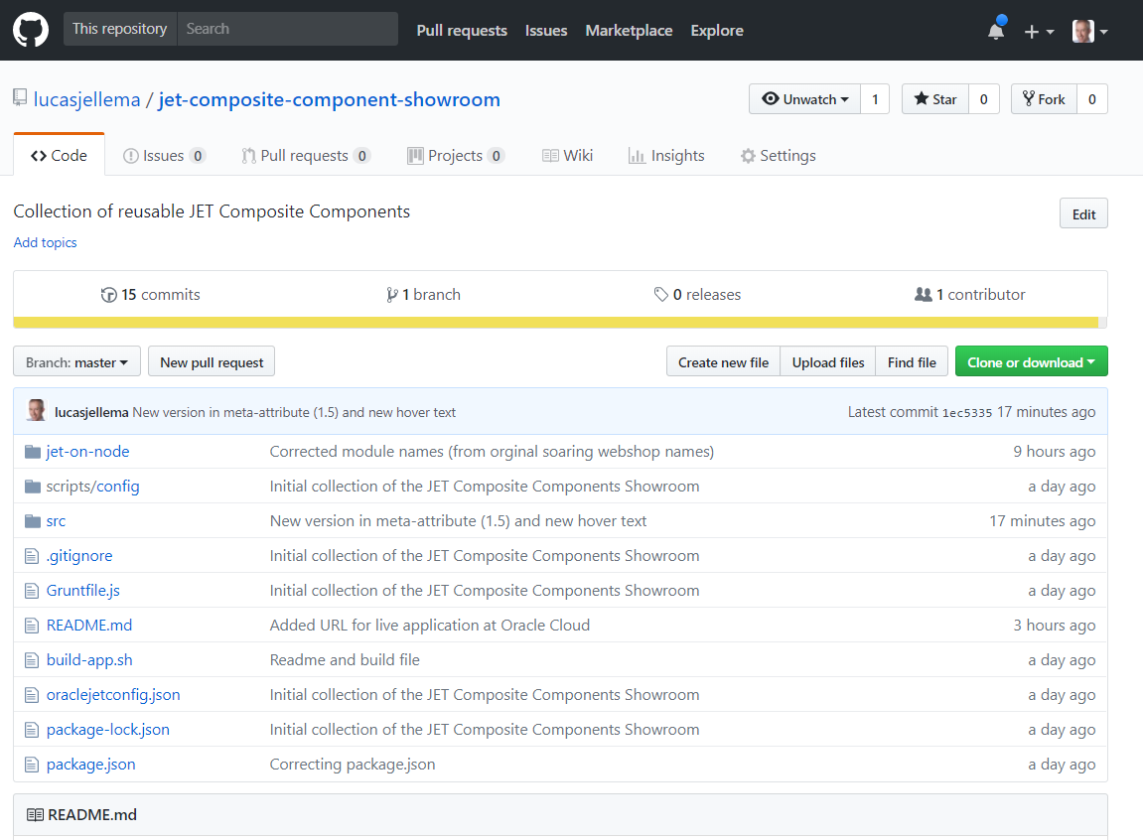
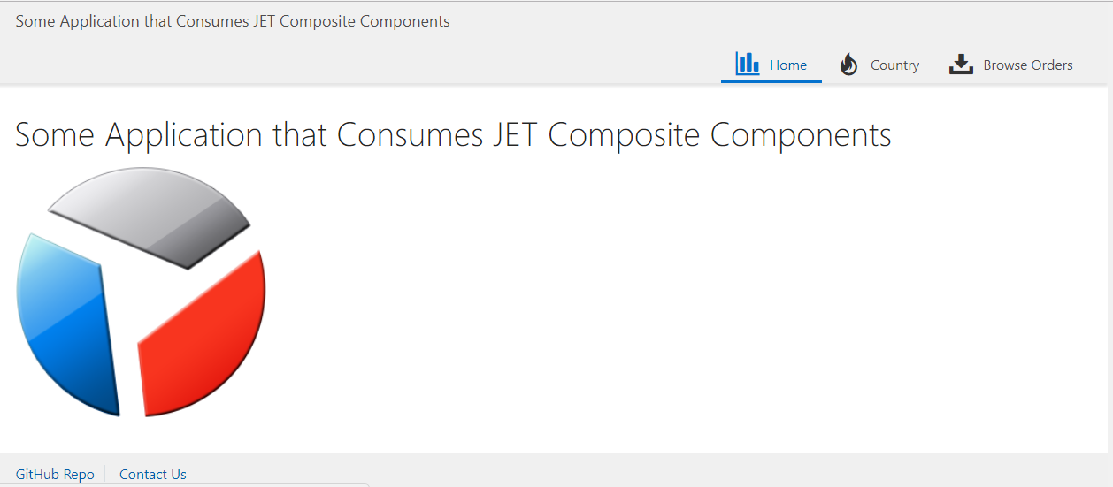


From developer’s commit & push to updated live application
4
2
Commit & push
3
WebHook Push
1
API <public>, /update, /github/push
Fetch and Write updated JET Composite Component Sources
jccm
JET sources

Slide 20
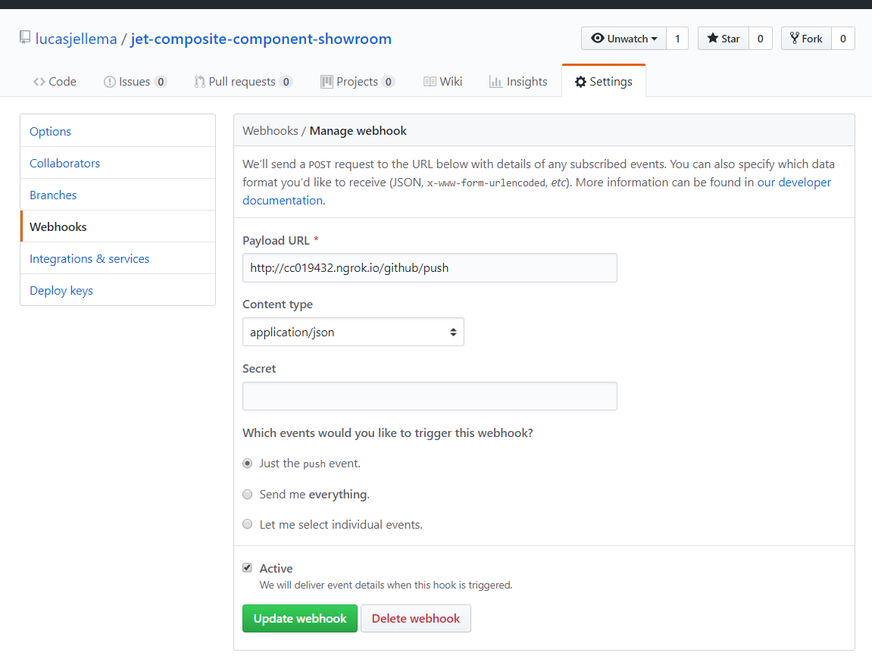
Configure WebHook for GitHub Repo that contains sources for JET Composite Component(s)

Slide 21
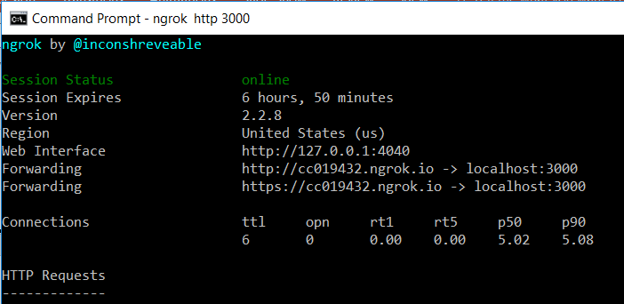
In this case, the JET Application runs locally
Expose local host through ngrok to GitHub

Slide 22
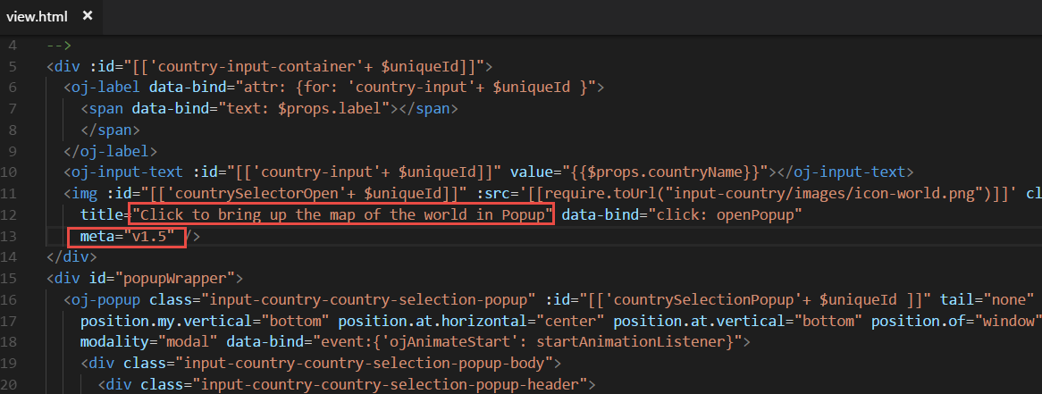
Make change – and commit and push

Slide 23
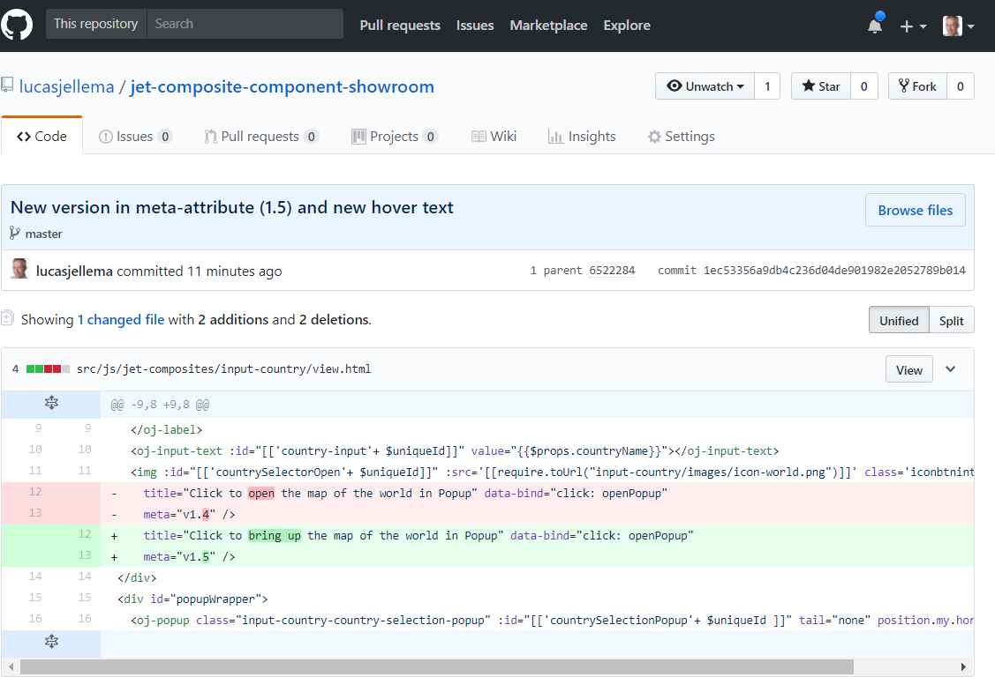

Slide 24
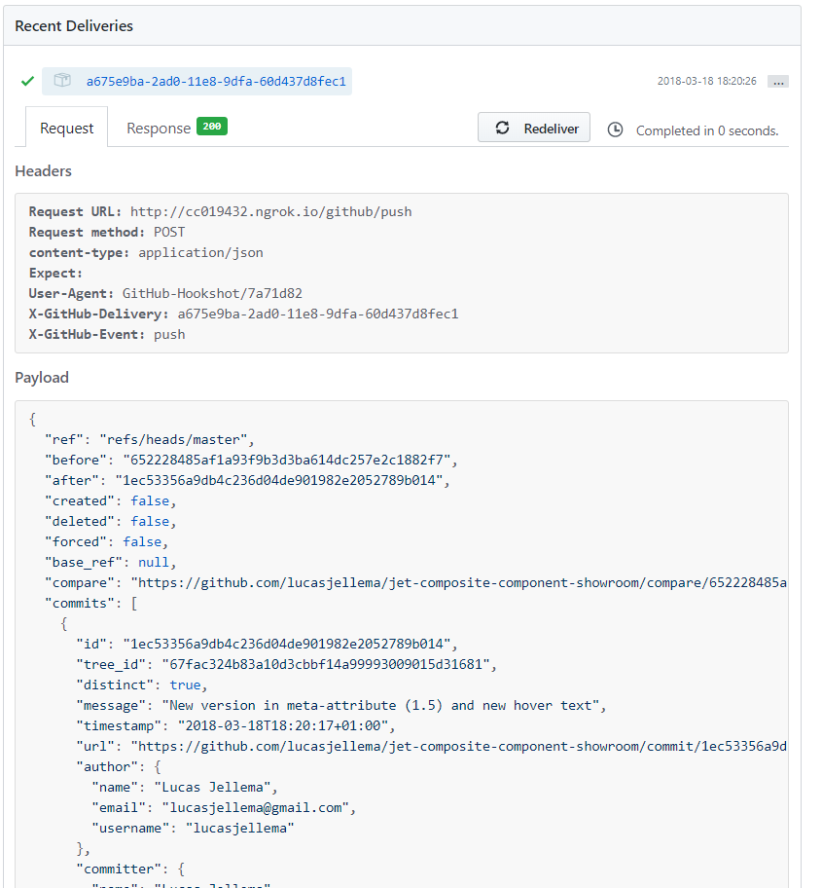
The GitHub Push Event that was sent

Slide 25
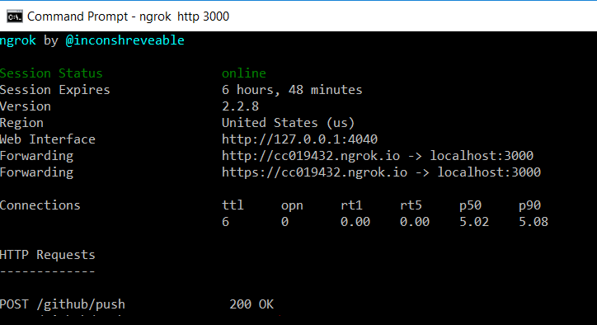
A push event was channeled through NGROK to the localhost server running at port 3000

Slide 26
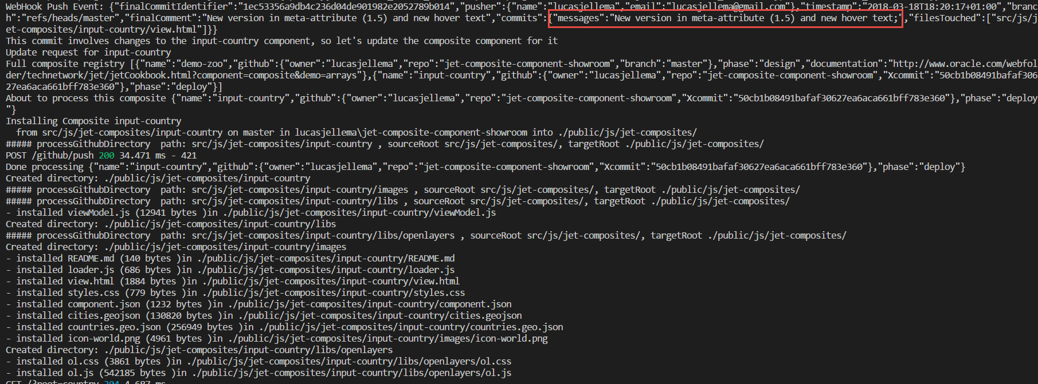
WebHook pushes event to Node application
Based on the info in the push event, it is decided that the input-country component should be refreshed

Slide 27
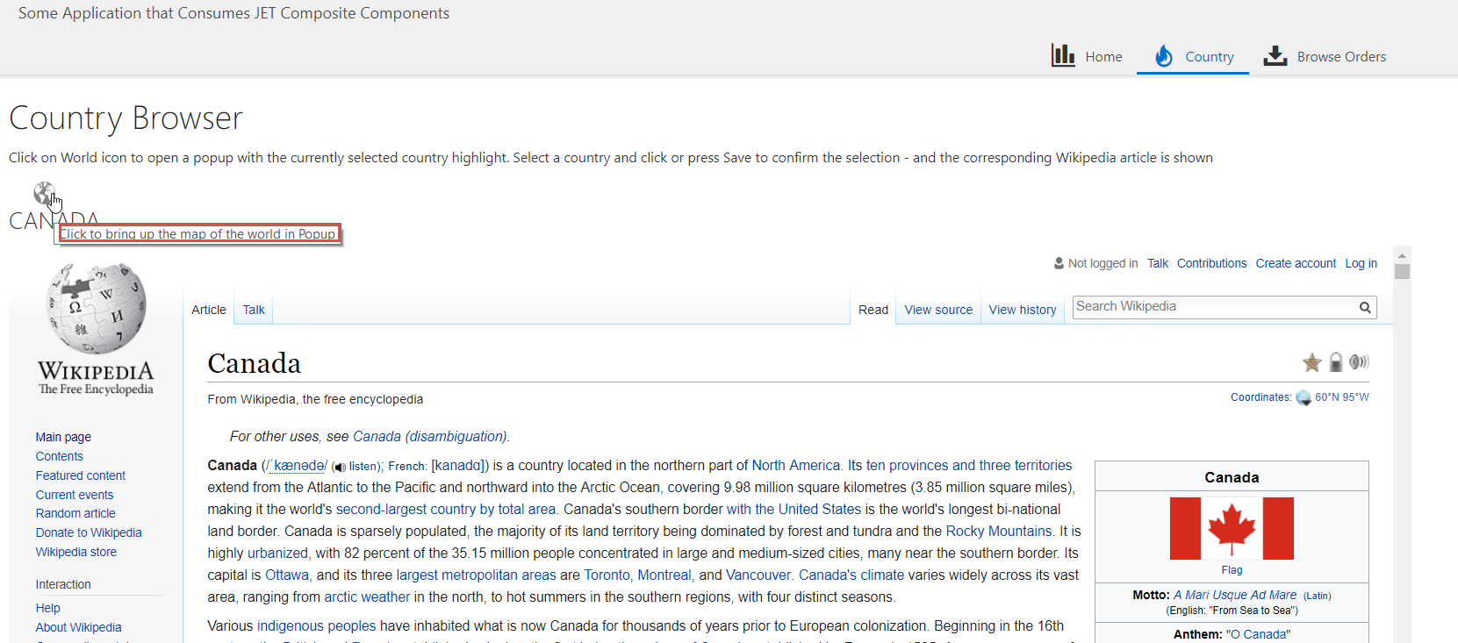
After a browser refresh – the changes are now live

Slide 28




Thank you!
Blog: technology.amis.nl
Email: lucas.jellema@amis.nl
: @lucasjellema
: lucas-jellema
: www.amis.nl, info@amis.nl

